Slide 1
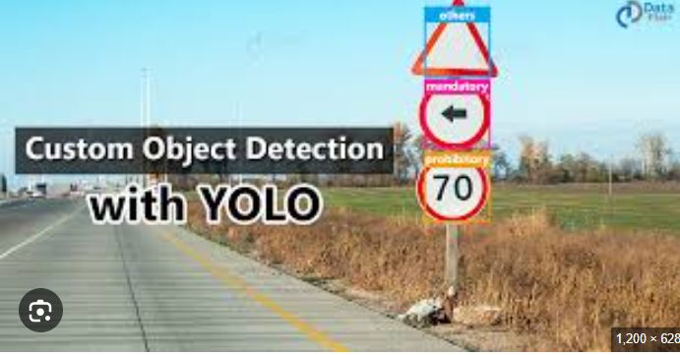
Custom Object Recognition
Name-Debasis Panda
Project-10
Group-VI

Slide 2
OCR Case-Flow
Objective
Environment Set up and Data pre paration
Model Training
Inference and Post-Processing
Model Evaluation
Model Deployment

Slide 3
Objective
Build a Custom OCR by combining YOLO and Tesseract, to read the specific contents of a Lab Report and convert it into an editable file.
YOLO_V3 to trained on the personal dataset
The coordinates of the detected objects are passed for cropping the detected objects and storing them in another list
This list is passed through the Tesseract to get the desired output
The Model has been deployed using Streamlit and text has been extracted from the stored locations of the images in Google Drive

Slide 4
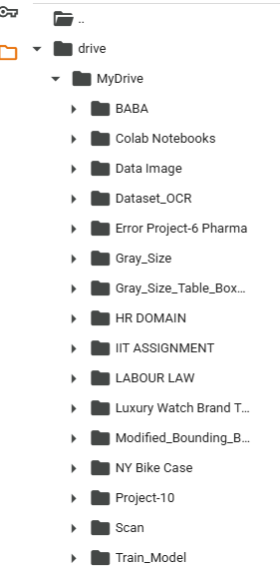
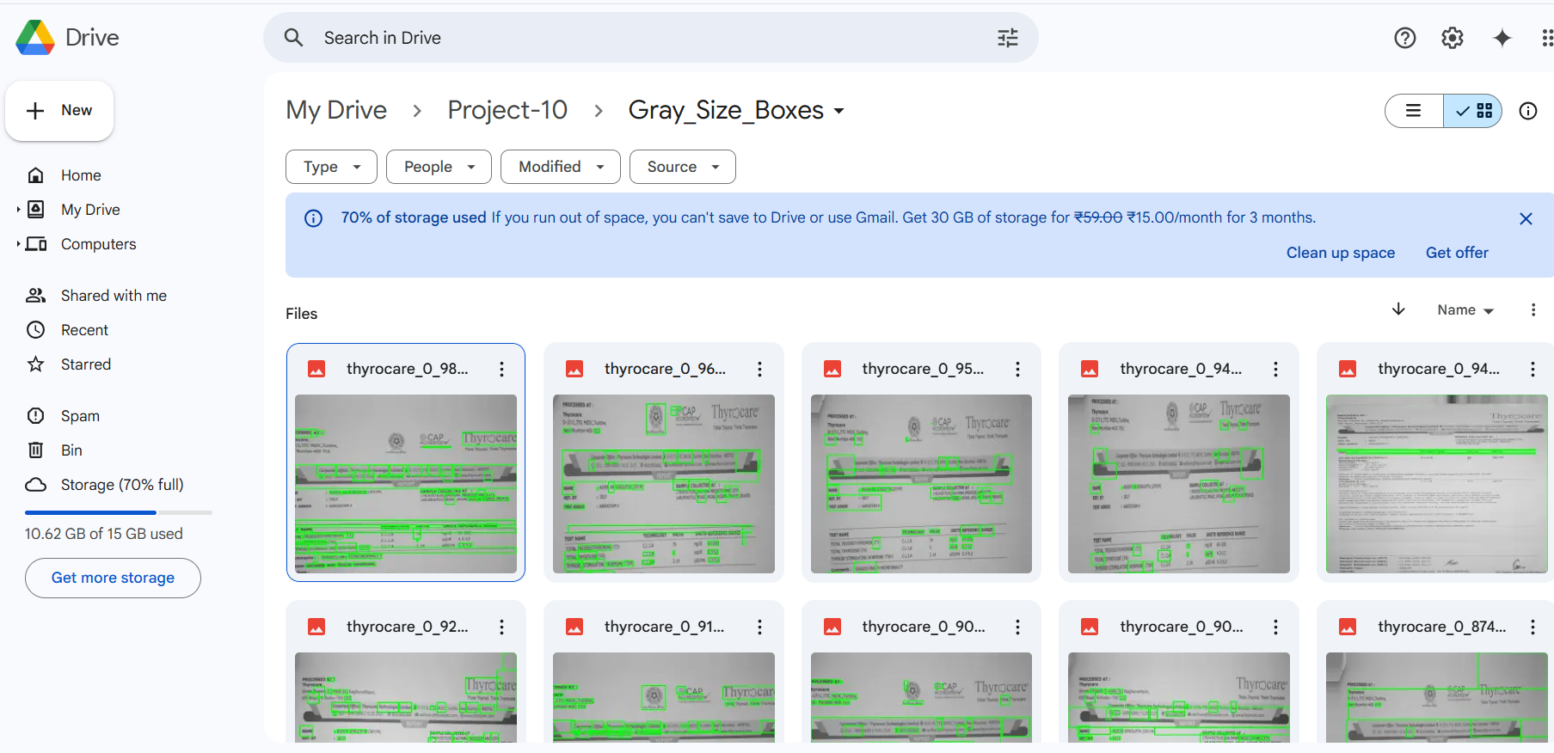
Environment Set up and Data Preparation
Google drive has been mounted and the folder structures/paths have been defined
Necessary Libraries were imported Tesseract, PyTesseract, Open CV, and YOLOv3.
Weights and configurations have been imported
Color images were imported to the Dataset_OCR folder
Images were resized and converted to gray using cv2
Bounding boxes were created around the gray sized images and
saved at /content/drive/MyDrive/Project-10/Gray_Size_Boxes
Texts were extracted from the above path location files using
pytesseract
Fig 2: Gray size files
Fig-1: Folder and File structure

Slide 5
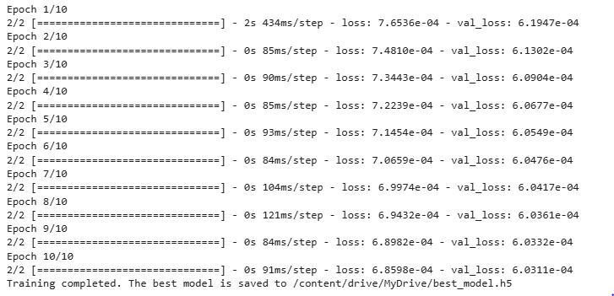
Model Training
Extracting features from images using OCR with Tesseract
Training an LSTM model for text analysis was done
The Best Model was saved as best_model.h5 in /content/drive/MyDrive/best_model.h5
YOLOv3 model using pre-trained weights (yolov3.pt). This speeds up training by leveraging existing knowledge.
YOLOv3 training focuses on teaching the model to locate important regions in the images (object detection).
Content extraction focuses on extracting the text from those regions (OCR).
The LSTM model will potentially analyze the extracted text for further insights.
Fig-1:Model Training

Slide 6
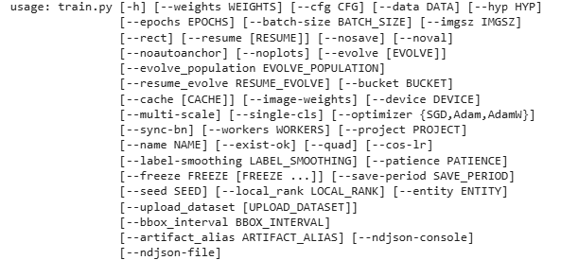
Inference and Post-Processing
Combined Inference and Post-processing: The code integrates the YOLO inference and the post-processing steps (cropping, preprocessing, OCR) within the run_inference_and_extract function.
Object Detection and OCR: It uses YOLO to detect objects, extracts their bounding boxes, and then applies Tesseract OCR to the cropped regions to extract text.
Preprocessing: The cropped images undergo preprocessing, including conversion to grayscale, blurring, and thresholding, to improve OCR accuracy.
Saving Results: The extracted text, along with metadata like filename, object name, confidence, and bounding box, is saved to a CSV file in your Google Drive
Fig-1: Weight assignment and validations

Slide 7
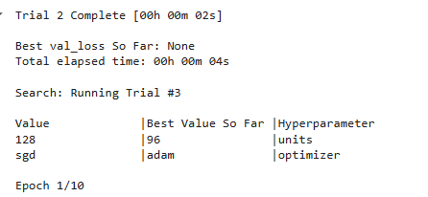
Model Evaluation
Model Hyper tuning
Optimize Preprocessing: The code includes steps for resizing and converting images to grayscale. Other preprocessing techniques before passing images to Tesseract, such as noise reduction, thresholding, or deskewing, to potentially improve Tesseract's accuracy. Hyper tuning shows the responses are 96 units and adam optimizer respectively for better accuracy
Improve Tesseract Output: Pytesseract has various configuration options (config parameter in image_to_string) that can be used to fine-tune its behavior for different types of text or images.
Model Fine-tuning (YOLO): While the code trains an LSTM model for feature extraction/reconstruction, the core OCR part relies on YOLO for bounding boxes and Tesseract for text. To improve the overall OCR accuracy, need to fine-tune the YOLO model to better detect the specific text regions in your images and potentially improve the Tesseract recognition by focusing on the cropped regions identified by YOLO.
Integrated Pipeline: The current code separates YOLO bounding box drawing and Tesseract text extraction. An improved approach for custom OCR would be to integrate these steps: use YOLO to detect the bounding boxes of text areas, crop those areas from the original image, and then pass the cropped images to Tesseract for more focused text recognition.

Slide 8
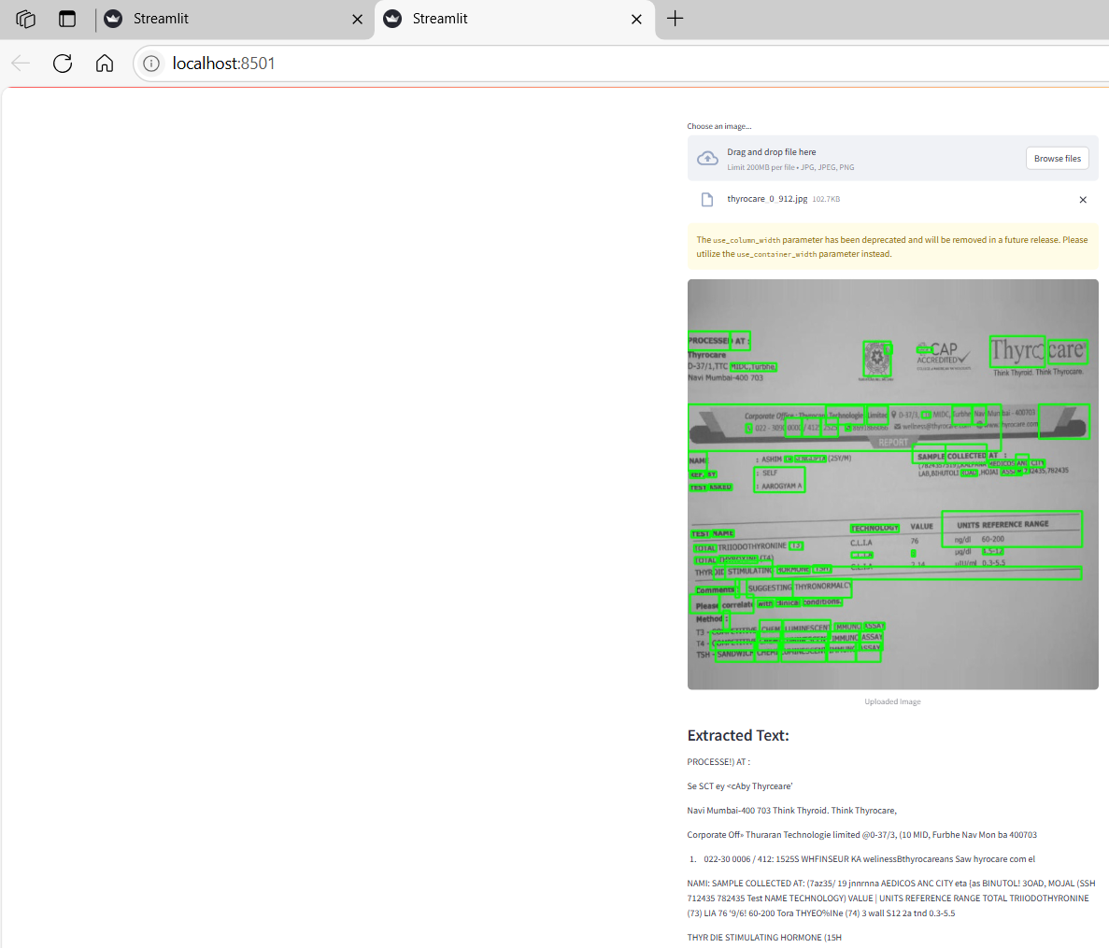
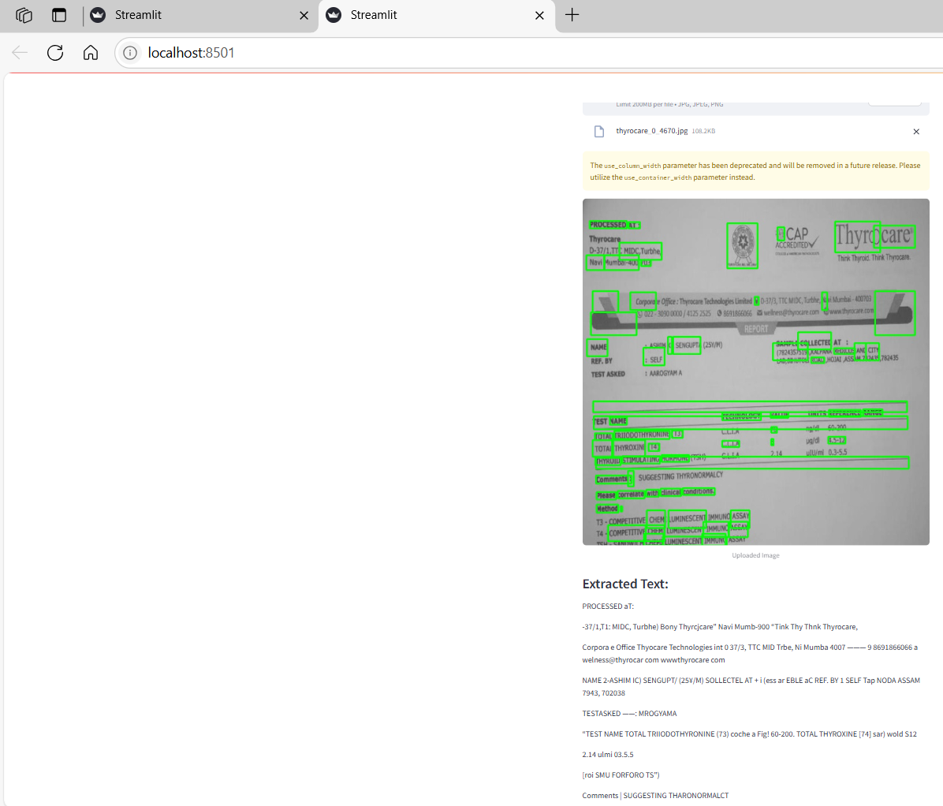
Deployment
Figure-1
Figure-2
Interpretation:
On a Local host, google drive has been displayed and file paths of the images were given as inputs on streamlit
Based on the inputs paths, the gray shaped images with bounding boxes were shown
Based on the best trained models using OCR ,Pytesseract and YOLO, the texts were extracted from the images

